Slide 1
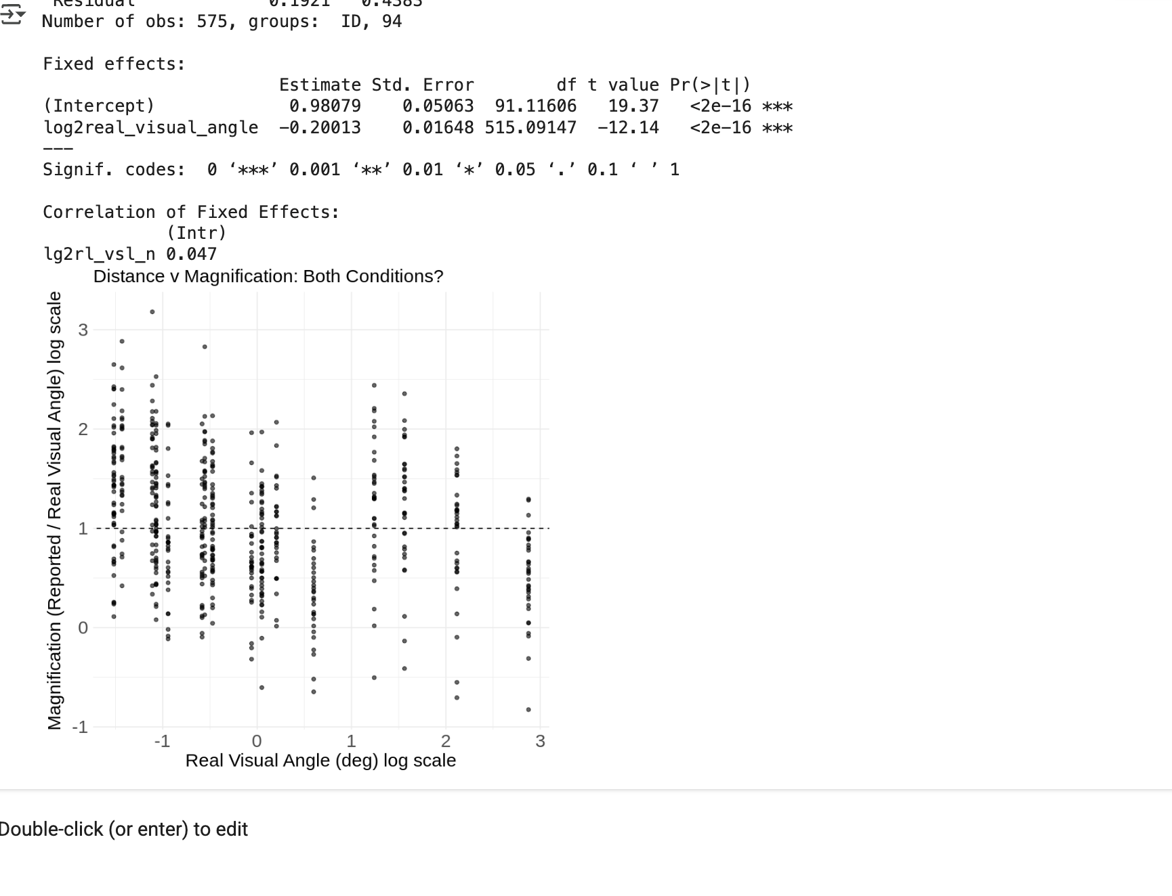
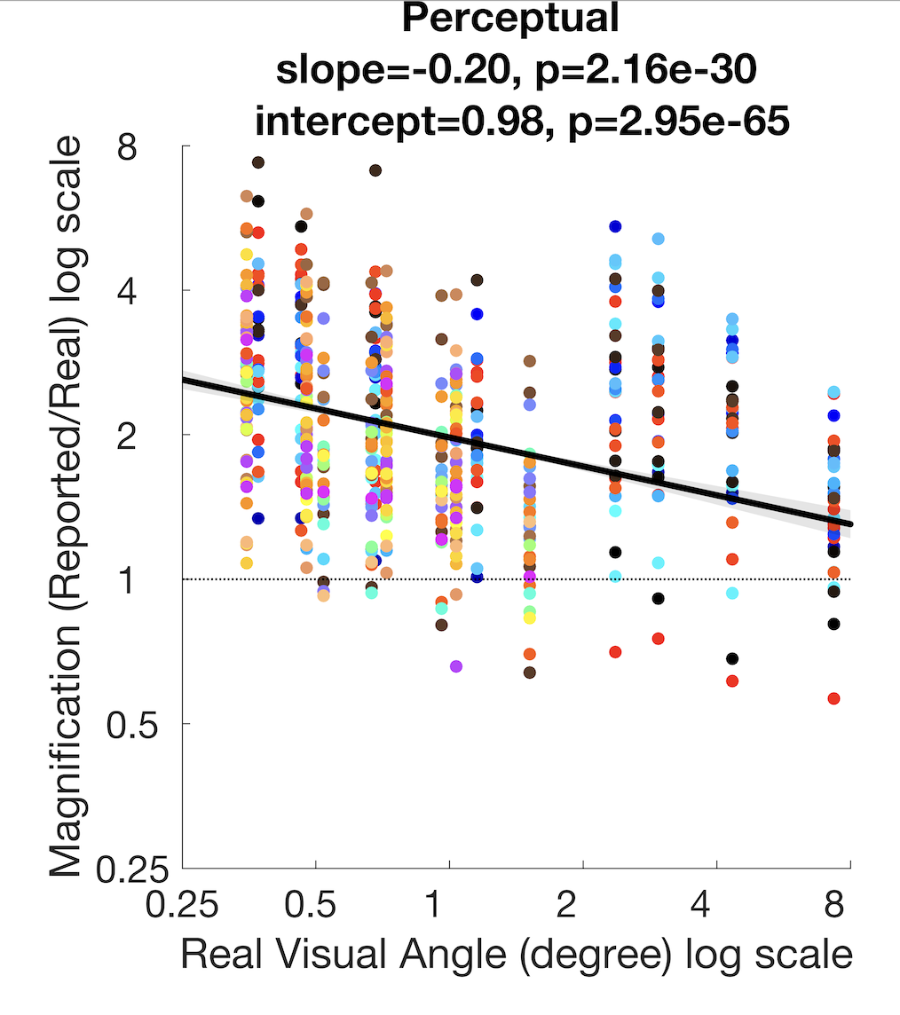
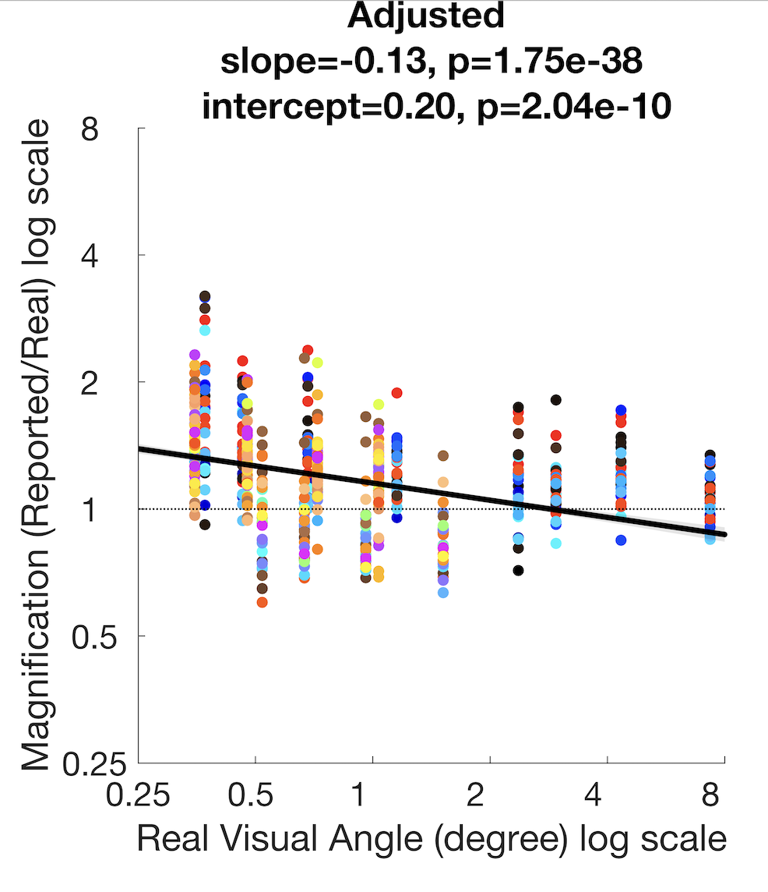
In the formula you fit the log of the values so the axes represent the log of the numbers. On the left I put in red the number that corresponds to the log2(number) so you can get a sense of what the scale is.
So all you angles are actually positive. When I plotted the graph I changed the x & y tick labels to the numbers to make it me interpretable. So I put these numbers on your graph too. And your angles are all positive
The thing that a log2 scale does is put multiple of 2 in regular intervals as otherwise on a regular (linear) scale, the intervals between 2 and 4 would have been smaller than from 4 to 8. And in the right, you can see my graphs; one more thing is that you need to fit the linear model separately for the adjusted and estimated case, so I don’t know what combined means in your analysis. Can you clarify this?
Your slope and intercept looks the same as from my code for the perceptual case so I am cautiously optimistic
Log 2(number)
number
-1=2⁻¹=1/2
0=2⁰=1
1=2¹=2
2=2²=4
3=2²=8
8
4
2
1
1/2
1/2
1
2
4
8

